Slide 1
European Emigration to the USA: Resources PowerPoint
Here are the additional resources to use with each section of the narrative, as specified in the Teacher Guide.

Slide 2
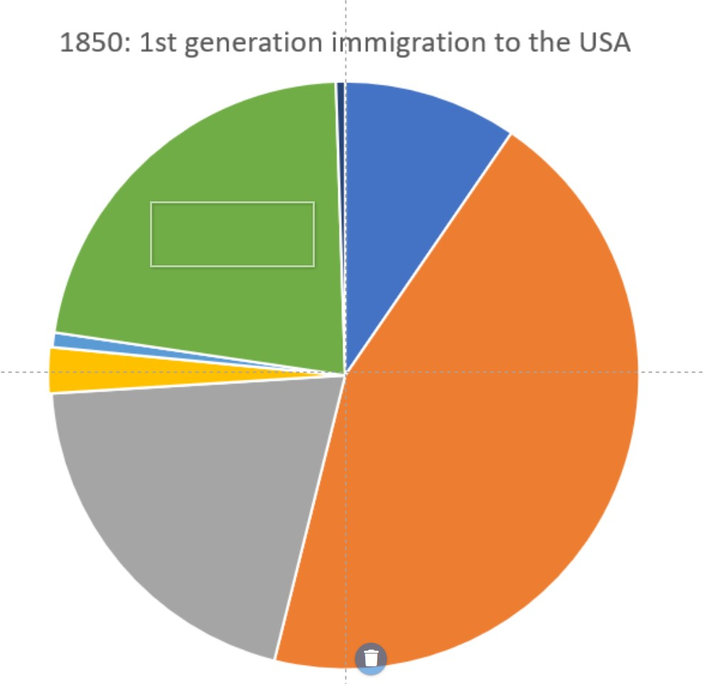
Resource for Introduction: Pie Chart 1850

Slide 3
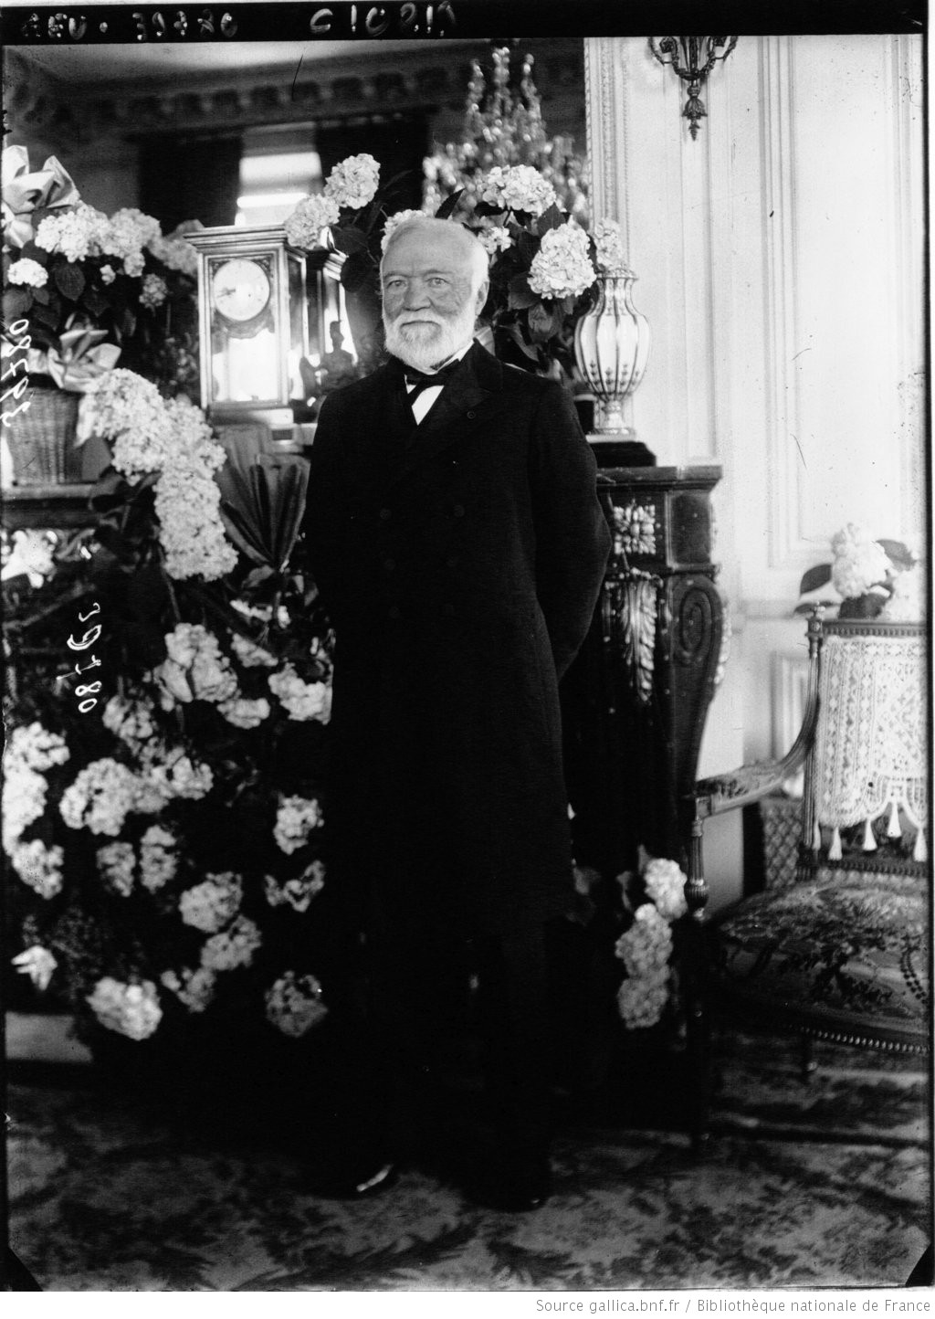
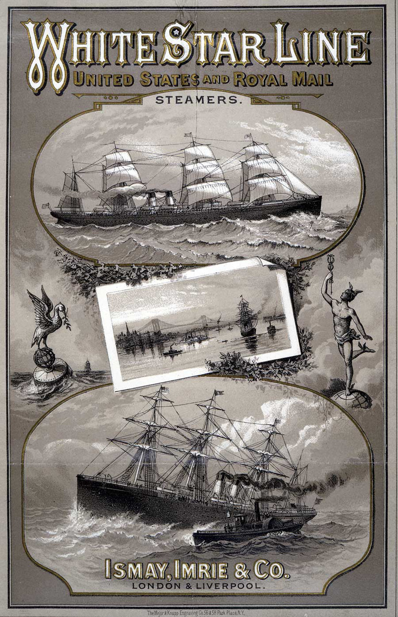
Resource for Reasons for Emigration: Push and Pull Factor Images – these need to be cut up so that students can sort them into two columns. Slide One
The American Dream - getting rich
Crossing the Atlantic became easier
The discovery of gold in California in 1848 and again in the Klondyke river in the Yukon territory in 1896 brought hundreds of thousands of prospectors seeking their fortune. Many of them were immigrants from Europe.
Native Americans had died in their millions of European-introduced diseases and were forced from their territories. This meant that there was also abundant land and resources for European people to take. The picture shows Andrew Carnegie. He was born in Scotland and emigrated to the United States in 1848. He became one of the richest individuals in America with his Carnegie Steel Company, which he sold in 1901 to John Pierpont Morgan for USD 480 million (some USD 14 billion in present-day value).
(Agence Meurisse, 1913, Gallica BnF via Europeana)
From the 1850s onwards European emigrants increasingly voyaged to America via steamship rather than sailing ship. These were quicker and fares were cheaper.
The White Star Line was one of the main shipping companies in the late 19th century, primarily due to its extensive transportation of migrants to North America. (1883, Wellcome Library via Europeana)

Slide 4
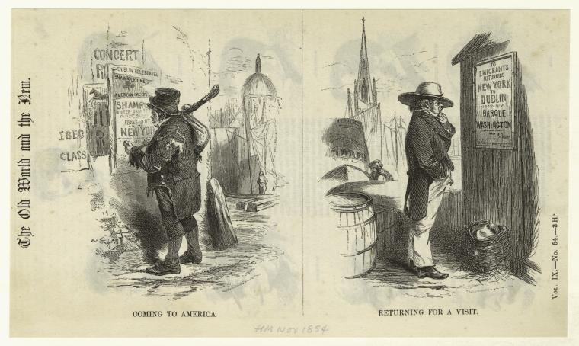
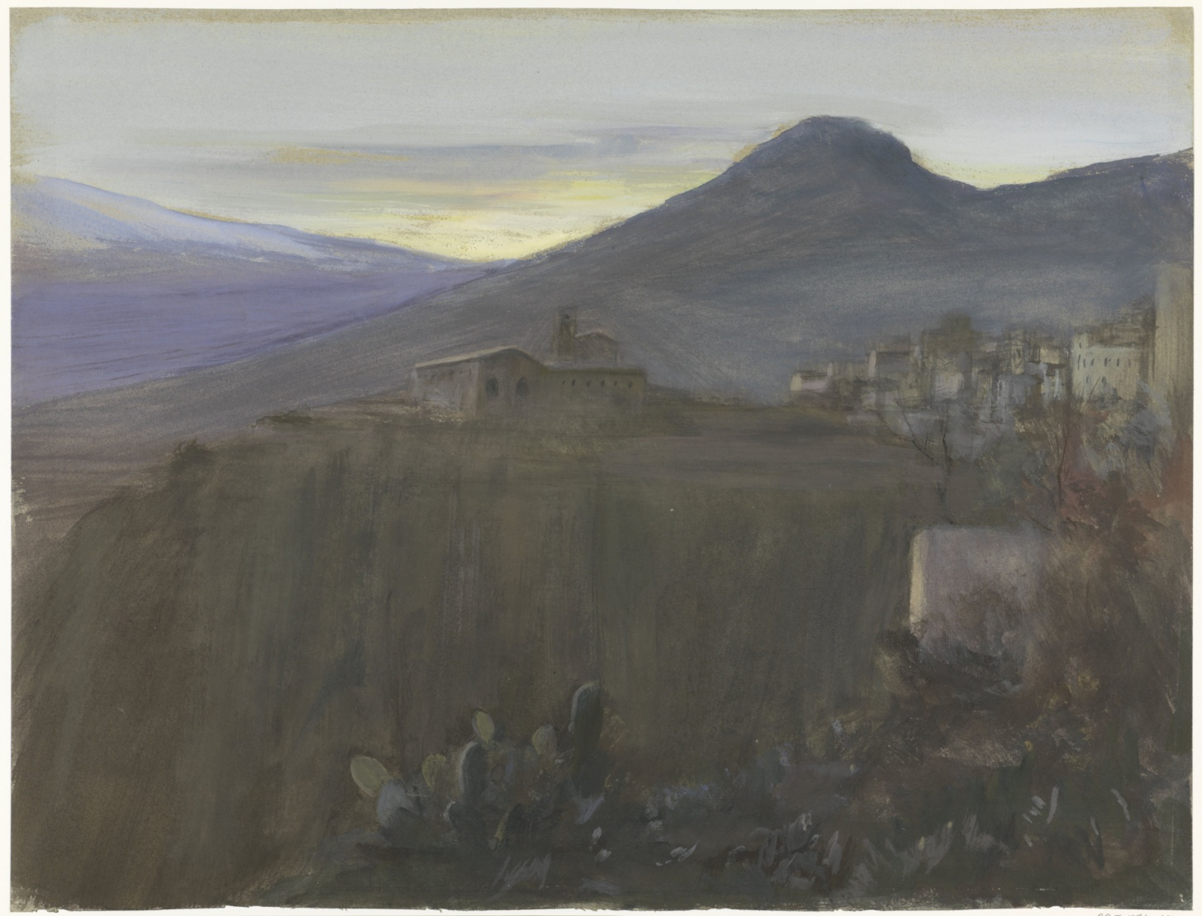
Resource for Reasons for Emigration: Push and Pull Factor Images – these need to be cut up so that students can sort them into two columns. Slide Two
Clearances and ethnic cleansing
Clearances of people off the land took place across much of Europe in the early and mid-19th Century, for example in Scotland. Some ethnic cleansing also took place, for example in Poland. Emigration was the only option for many.
The image is: “The Old World and the New. Coming to America; Returning for a Visit.” (Richardson & Cox, 1854, The New York Public Library via Europeana)
A continent with a regionally uneven pace of industrialisation
A large portion of European emigrants to the US in the later 19th century migrated from the rural areas of (southern) Europe where there were less opportunities for work in industrial cities. (Taormina, Sicily, Bramine Hubrecht, 1865-1913, Rijksmuseum via Europeana)

Slide 5
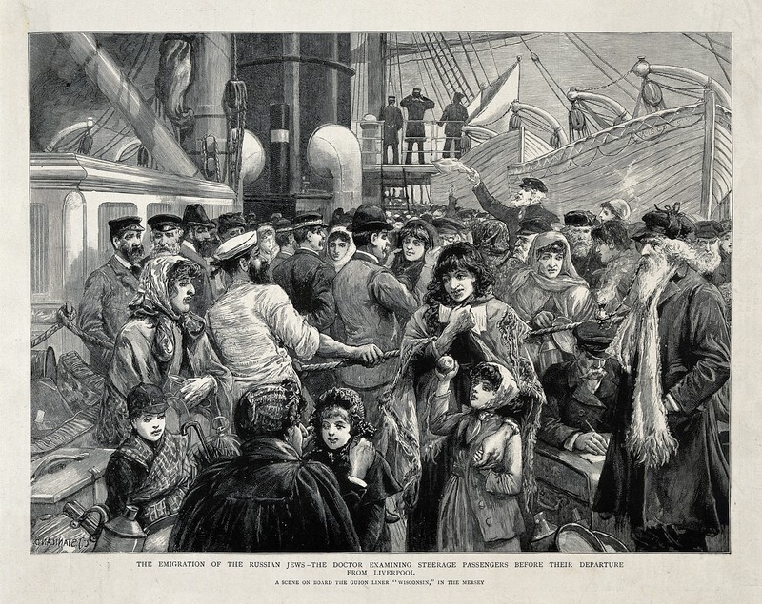
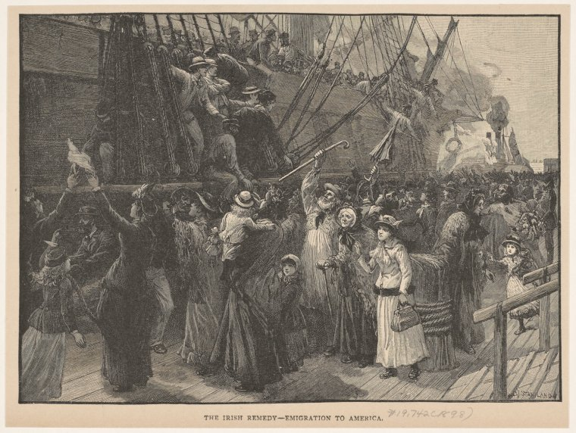
Resource for Reasons for Emigration: Push and Pull Factor Images – these need to be cut up so that students can sort them into two columns. Slide Three
Pograms
Pogroms were violent attacks on minorities, particularly Jews. For example, in the region of the Russian Empire known as the Pale of Settlement. This included western Russia, parts of Poland and Ukraine, Belarus, Moldova, Lithuania and Latvia. In the mid-1930s pogroms against German Jews became a feature of everyday life in the Third Reich. There are over one million Americans who are of Romani extraction. Many of their ancestors migrated from central and eastern Europe between the 1850s and World War 2 to escape persecution.
The image shows Russian Jews being examined by a doctor prior to their emigration from Liverpool (United Kingdom) in 1891.
(1891, Wellcome Library via Europeana)
Poor harvests and famine
In northern Europe, there were poor harvests in the 1840s and again in the 1860s due to bad weather and diseases such as potato blight, which hit Ireland particularly badly. Facing prolonged famines many peasants and farm labourers from northern Europe had little choice but to emigrate.
The image is called: “The Irish Remedy – Emigration to America.” (Charles J. Staniland, 1898, The New York Public Library via Europeana)

Slide 6
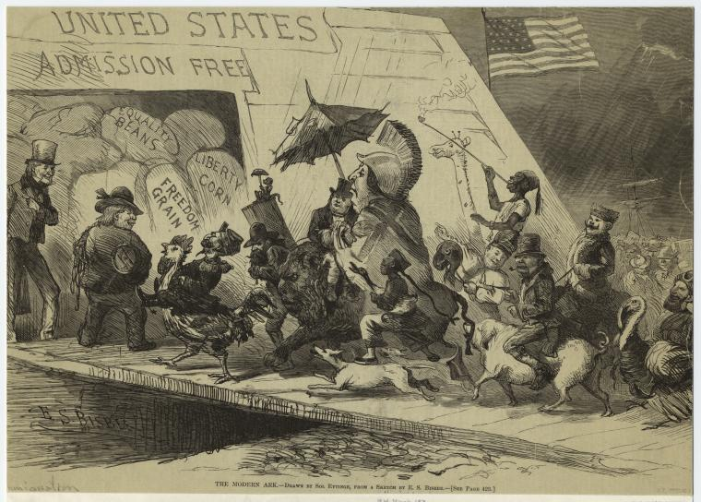
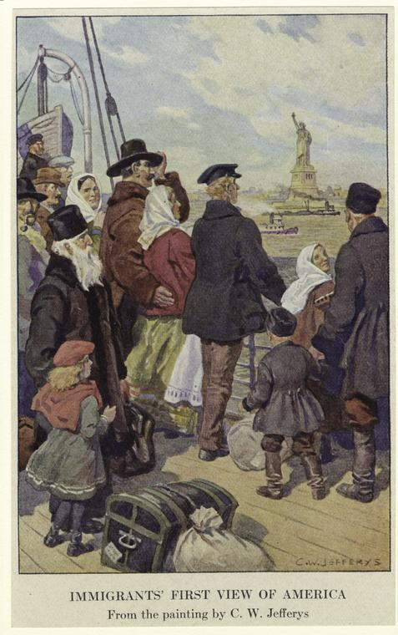
Resource for Reasons for Emigration: Push and Pull Factor Images – these need to be cut up so that students can sort them into two columns. Slide Four
‘The Land of the Free’
The USA continued to be a place where there was relatively more freedom of speech, of political allegiance and of religious belief than was the case in many parts of Europe.
The images shows the Liberty Statue in New York Harbour as the “immigrants’ first view of America.” (Charles W. Jefferys, The New York Public Library via Europeana)
US companies wanted to attract people
There were financial incentives that attracted many Europeans. The railway companies were keen to attract immigrants with farming experience to settle on the land close to the new railroad tracks.
In the image the USA is depicted as “the modern ark,” attracting peoples from across the world with “quality beans,” “freedom grain,” and “liberty corn." (The modern ark, Ezra Bisbee and Solomon Eytinge, 1871, The New York Public Library via Europeana)

Slide 7
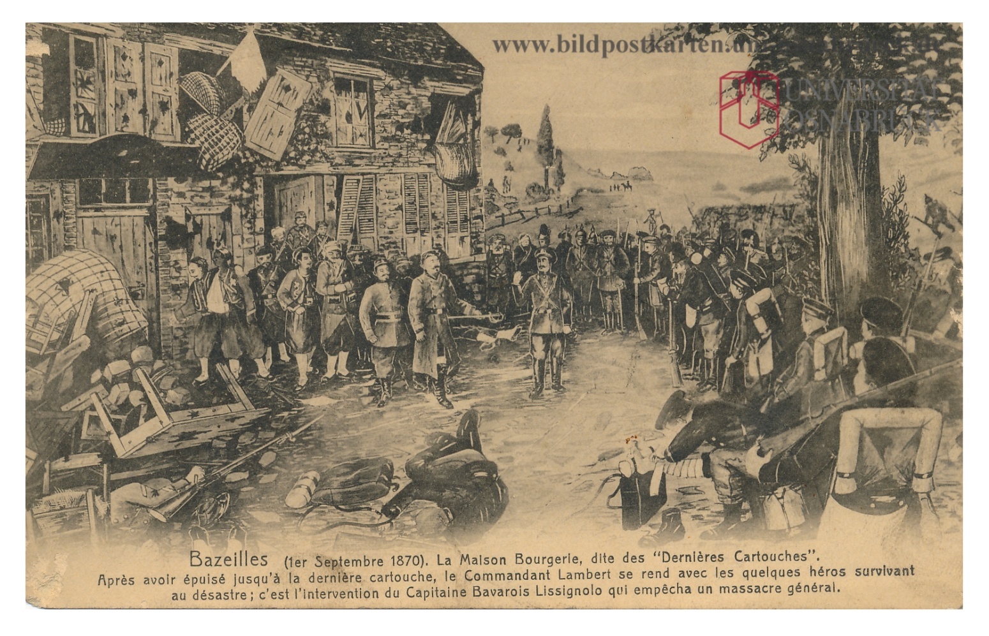
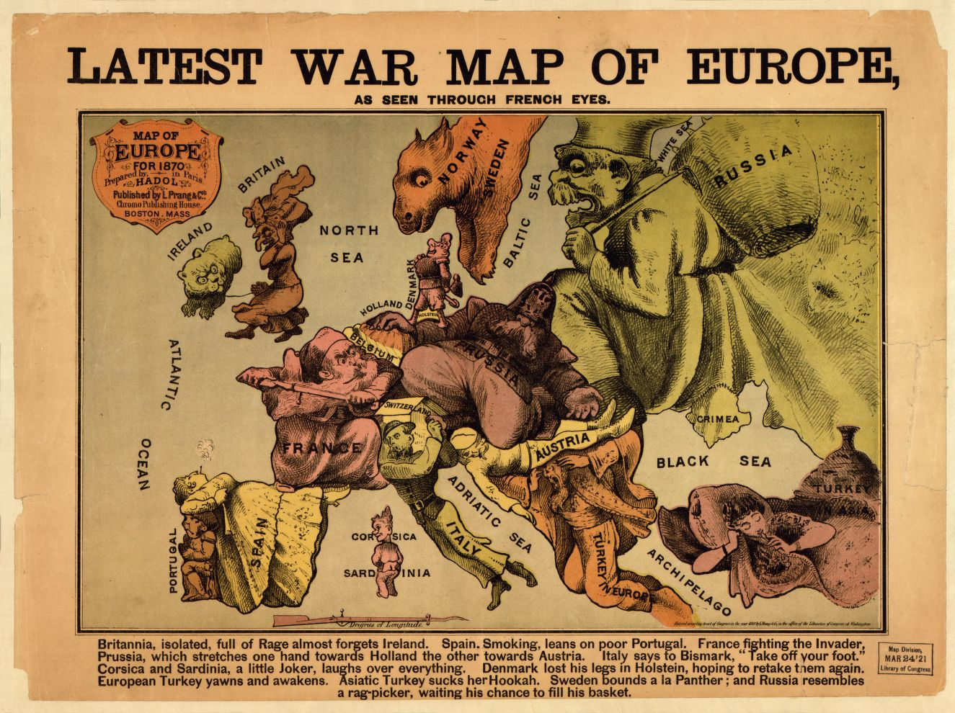
Resource for Reasons for Emigration: Push and Pull Factor Images – these need to be cut up so that students can sort them into two columns. Slide Five
Political Turmoil
There were revolutions and attempted revolutions in various parts of Europe across the 19th century. When rebellions were forcibly suppressed many revolutionaries emigrated to escape the authorities.
The image is a postcards from the Franco-Prussian War (1870-1871).
(J. Winling, Universität Osnabrück via Europeana)
Fleeing from war in Europe
War drives people from their homes. This happened in Alsace as a result of the Franco-Prussian war, there were refugees from the Balkan Wars (1912-13) and from the First and Second World Wars. Some of these asylum seekers emigrated to the USA.
(Paul Hadol, 1870, Library of Congress)

Slide 8
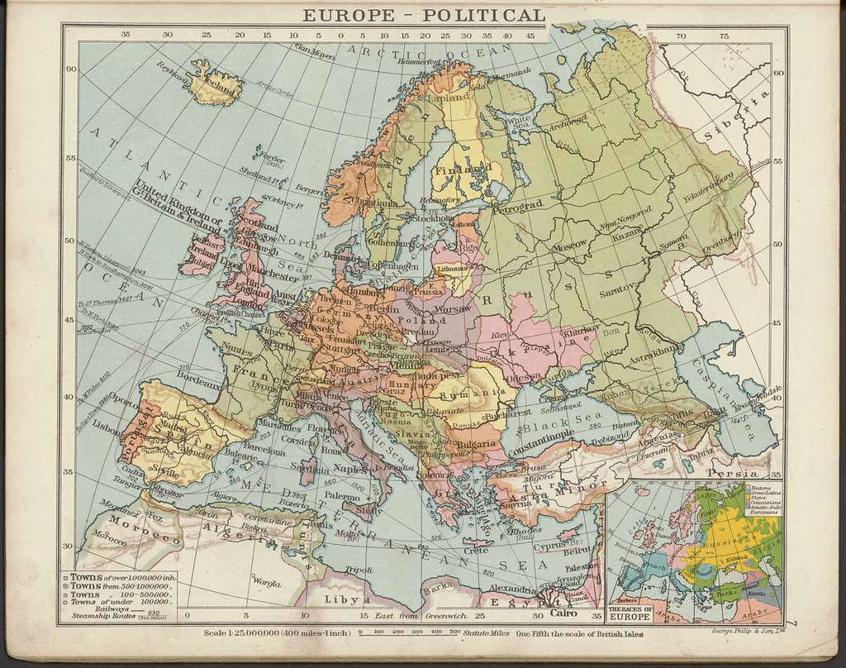
Resource for the Voyage to a New Life in America – Map of Europe in c. 1920
Notes:
Source CC: https://picryl.com/media/philips-elementary-atlas-of-comparative-geography-ca-1920-65018646-3e5417

Slide 9
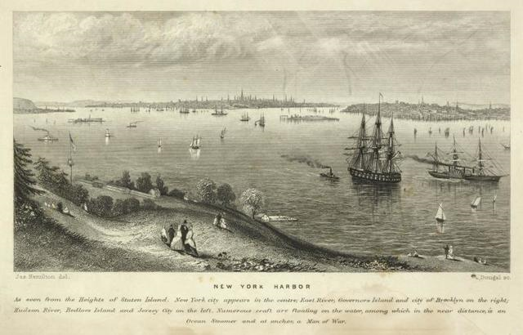
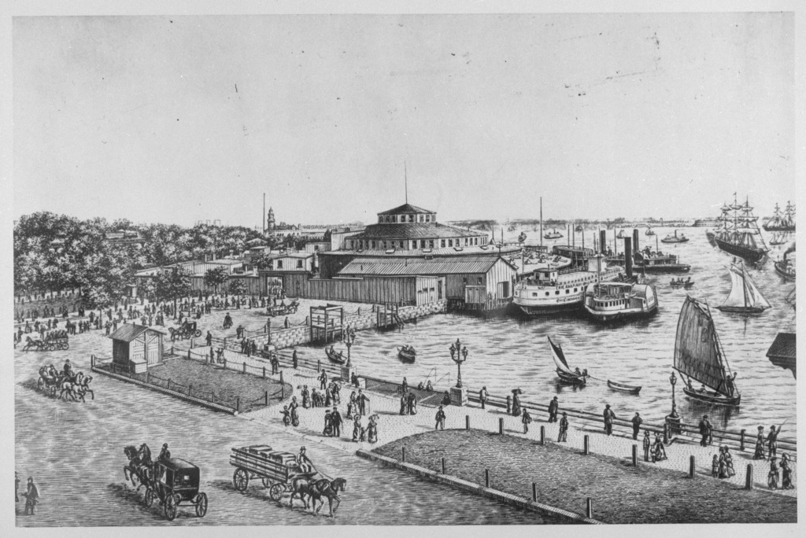
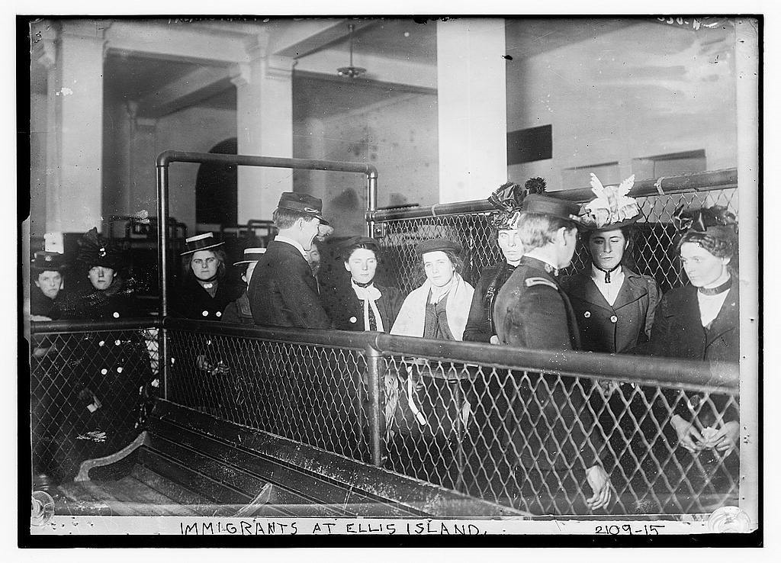
Resource for the Emigrants become Immigrants – Storyboard
New York Harbor, 1849
Castle Island, 1855
Ellis Island, 1900
The historical context:
The historical context:
The historical context:

Slide 10
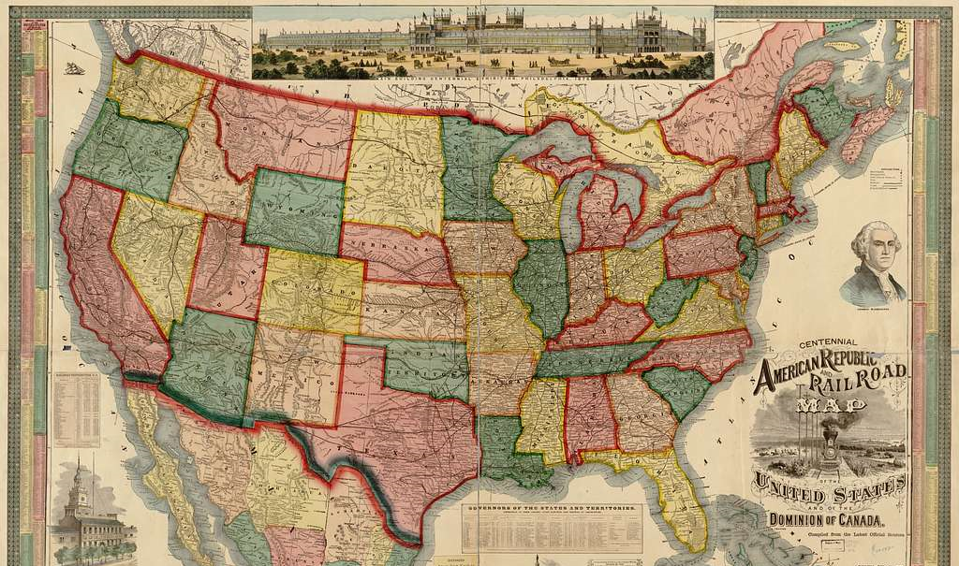
Resource for the New Americans – map from 1876

Slide 11
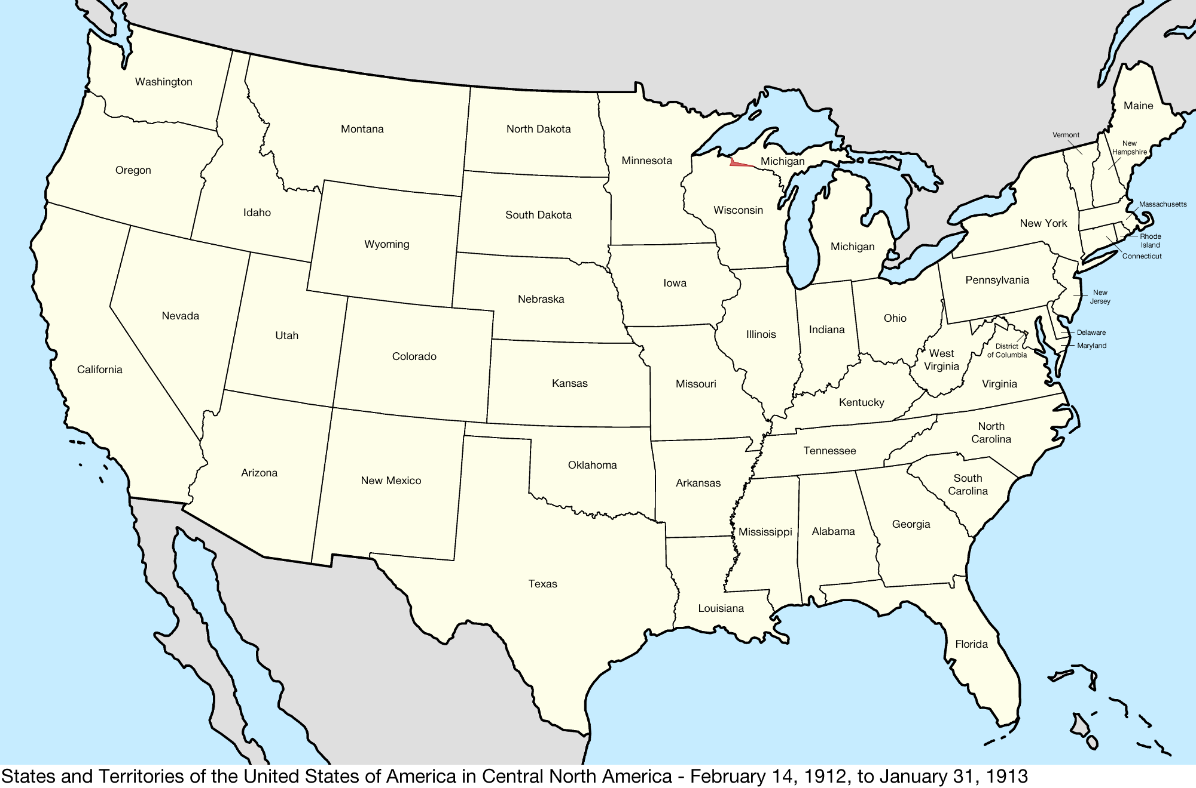
Resource for the New Americans – outline map of USA in 1913

